Slide 1


A comprehensive study on India’s position In Happiness Index
A Exploratory Data Analysis Project in partial fulfilment of requirement for statistics course (STS-1) of Post Graduate Program In Data Science
Prepared by,
Trilokesh Ranjan Sarkar (Roll No. - A23047)
DS fall 2023 Batch
Project Supervisor
Dr. Sayantani Roy Choudhury

Slide 2
Objectives behind the Project :
Identify Key Determinants: Identify and rank the key determinants that contribute to or hinder a nation's happiness, such as economic stability, social support, human development, education.
Comparative Analysis:
Compare India's Happiness Index scores with those of other countries to gain insights into its global standing in terms of happiness and well-being.
Assess National Well-being:
Evaluate the overall well-being and happiness levels of India by analyzing various factors and their impact on happiness.
Data Visualization:
Create meaningful data visualizations, including maps, charts, and graphs, to effectively communicate findings and trends related to happiness within India.
Public Awareness:
Increase public awareness and understanding of the concept of happiness index and its relevance in policymaking and personal well-being
Predictive Modeling:
Develop predictive models that can forecast future happiness trends based on historical data and identified determinants.

Slide 3
Data Source
https://www.worldometers.info/gdp/gdp-per-capita
https://en.wikipedia.org/wiki/Social_Progress_Index
https://en.wikipedia.org/wiki/List_of_countries_by_literacy_rate
https://en.wikipedia.org/wiki/List_of_countries_by_life_expectancy
https://en.wikipedia.org/wiki/Corruption_Perceptions_Index
https://www.cafonline.org/about-us/publications/2022-publications/caf-world-giving-index-2022
https://hdr.undp.org/data-center/human-development-index
Methodology
Selection of the topic.
Secondary Data Collection from reliable sources.
Understanding the dependency of happiness index on various factors.
Exploratory data analysis interpretation and visualization.
Conclusion from the project

Slide 4
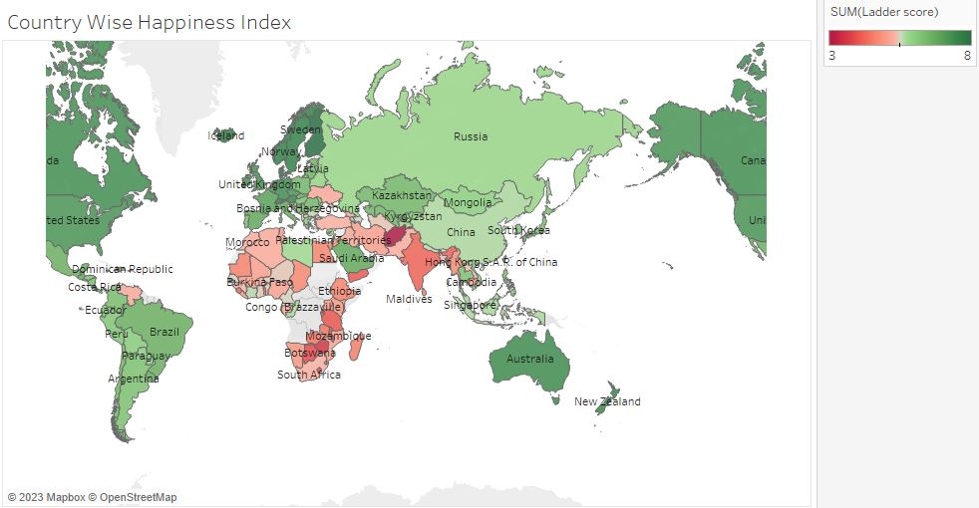
Analysis And Results

Slide 5
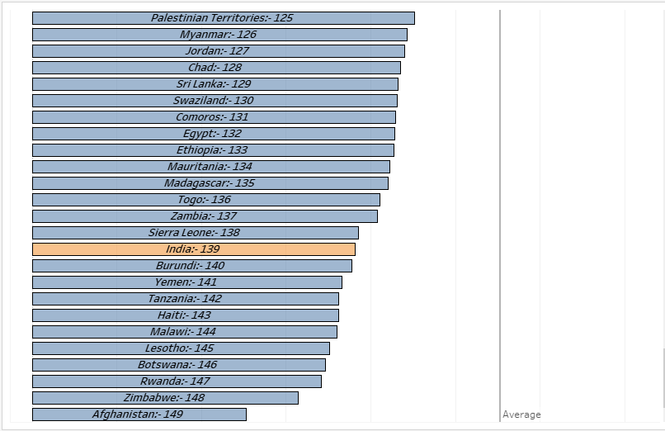
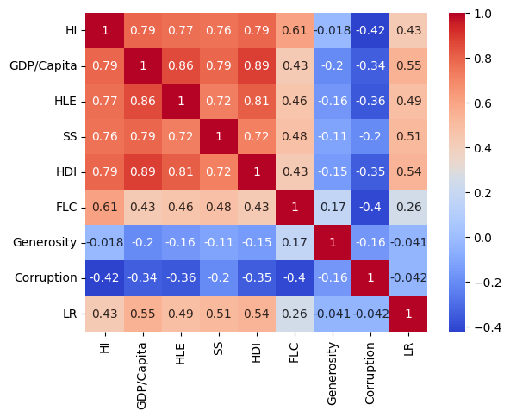
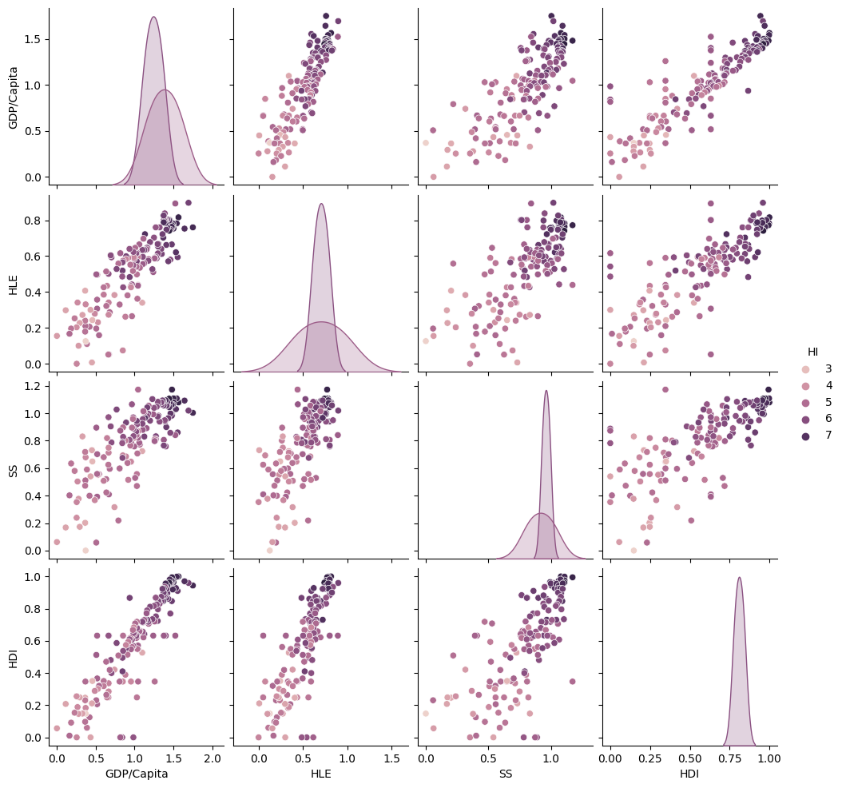
Correlation of Happiness Index with other factors
Top five factors on which the Happiness Index depends the most:
GDP per Capita
Life Expectancy
Social Support
Human Development
Learning Rate

Slide 6
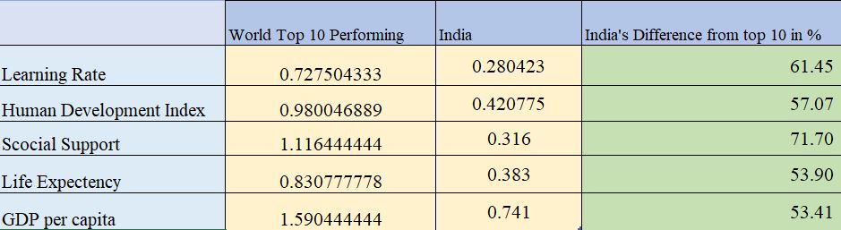

Slide 7
INTERPRETATION
From the world map shown, it is depicted that the Happiness index of India compared to other countries is very low.
India ranks 139th position in the year 2021 based on Happiness index score compared to other countries.
The Heat Map interprets the co-relation of different factors with happiness index for several countries. Also it can be interpreted that GDP per capita and Human Development index(HDI) has maximum co-relation with Happiness Index
Pair plot depicts the co-relation among the five major factors responsible for happiness index. GDP per capita and human development index(HDI) has better co-relation with Human life expectancy(HLE).
Although as a whole the co-relation between HI and GDP per capita is positive but in case of India the picture is different, even the GDP per capita increases the HI decreases.
India is mostly lagging in Social Support followed by Learning rate, Human Development index, Life expectancy , GDP per capita in compare to world’s top 10 performing countries.

Slide 8
Conclusion
In India the gross national income(GNI) is contributed by very few percentage of its population. So even if GNI increases, the GDP also increases but on the other hand as a large population has minimal income which adversely effects the happiness index.
GDP growth largely benefits a small portion of the population, emphasizing income inequality.
Government policies addressing inequality, healthcare, education, and social cohesion can increase overall happiness in India.
Improving education can enhance human development and happiness
Controlling population of the country can boost human development and happiness.

Slide 9
THANK YOU

